Slide 1

INTRODUCTION TO CHATGPT
USING AI TO HELP US WRITE CODE
FOR THE RASPBERRY PI

Slide 2


Slide 3
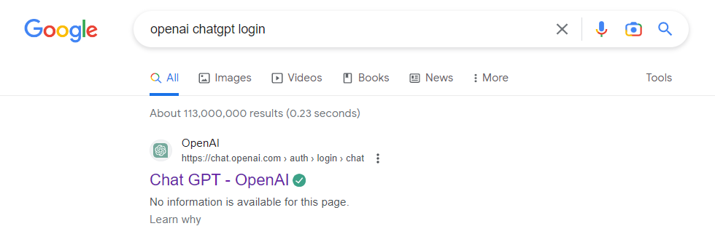

Slide 4

Click Log In and sign into your Gmail Account

Slide 5
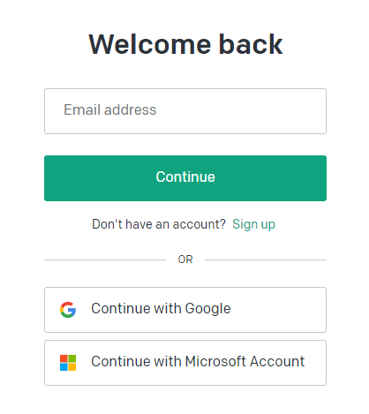
Click Continue with Google

Slide 6
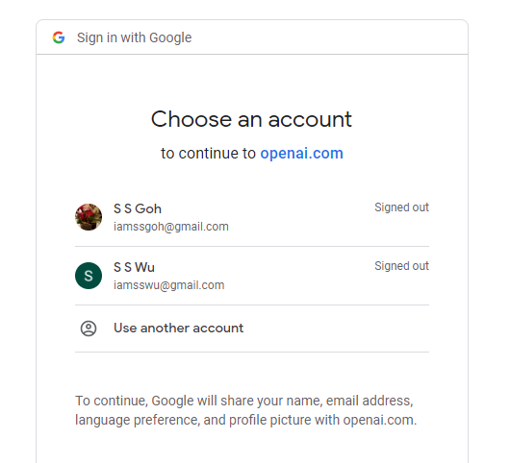
Choose the Gmail Account you want to use

Slide 7
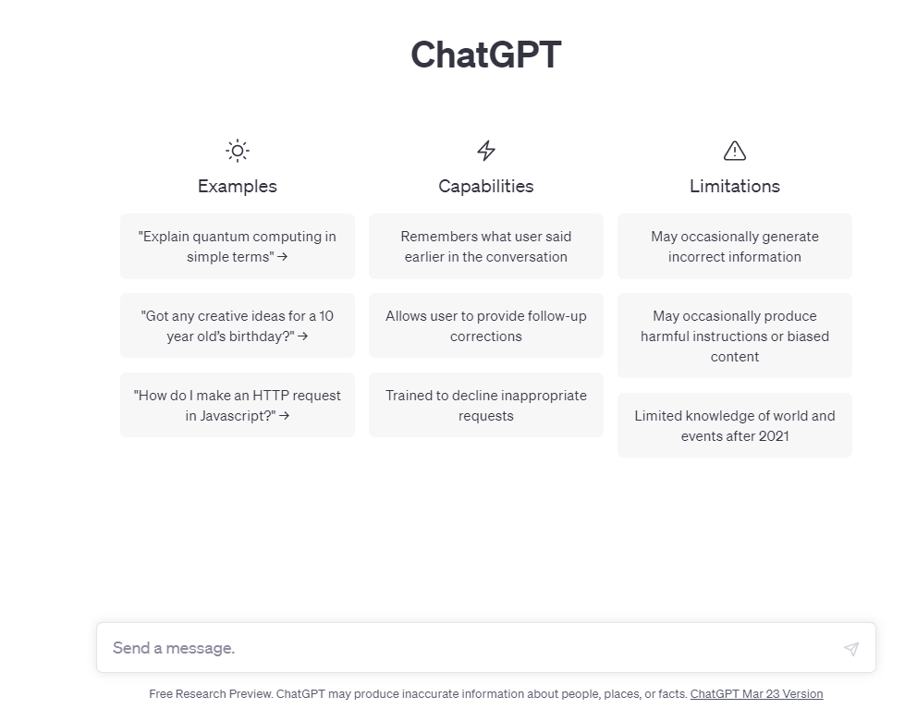
This is the text area for you to enter you queries

Slide 8
ILLUSTRATION

Slide 9
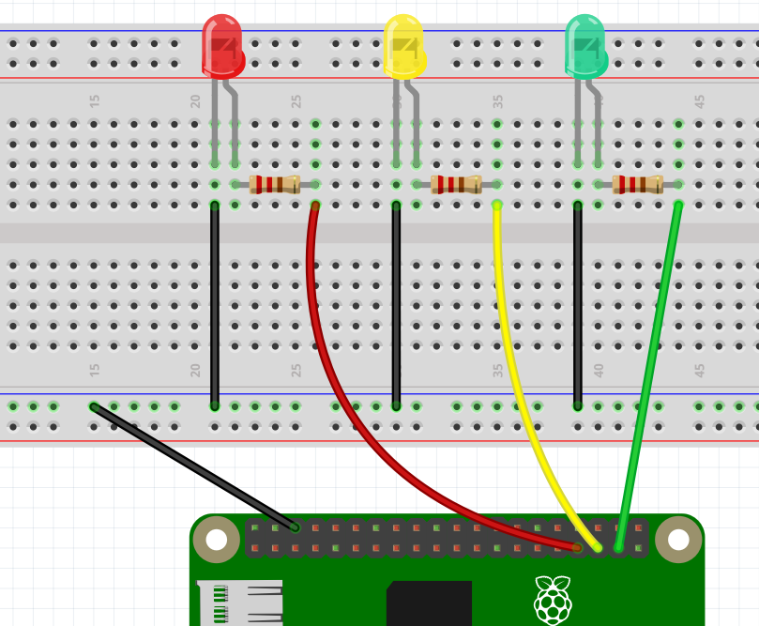
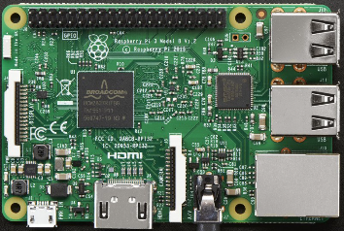

EXERCISE #2
Wiring for a Traffic Light
PIN 13
PIN 19
PIN 26
GROUND

Slide 10
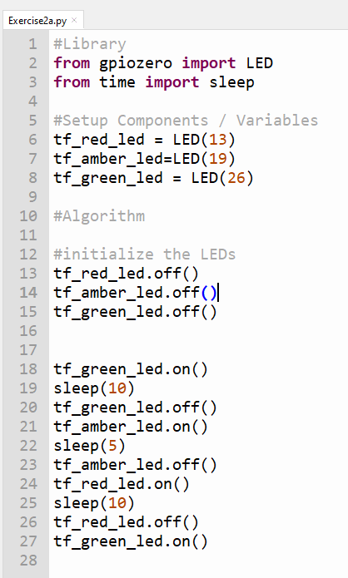
Ex. 2a – Using our knowledge from Exercise 1a-d,
we create a traffic light system.
Save program as Exercise2a.py
ALGORITHM FOR A TRAFFIC LIGHT SYSTEM
STARTS WITH GREEN
AFTER 10 SECONDS
GREEN GOES OFF
AMBER COMES ON
AFTER 5 SECONDS
AMBER GOES OFF
RED COMES ON
AFTER 10 SECONDS
RED GOES OFF
GREEN COMES ON

Slide 11
HOW SHOULD I ASK CHATGPT TO WRITE THE PROGRAM FOR ME?
Python program, raspberry pi, red LED is on pin 13, yellow LED on pin 19
And green LED on pin 26. use the following logic
STARTS WITH GREEN
AFTER 10 SECONDS
GREEN GOES OFF
AMBER COMES ON
AFTER 5 SECONDS
AMBER GOES OFF
RED COMES ON
AFTER 10 SECONDS
RED GOES OFF
GREEN COMES ON

Slide 12
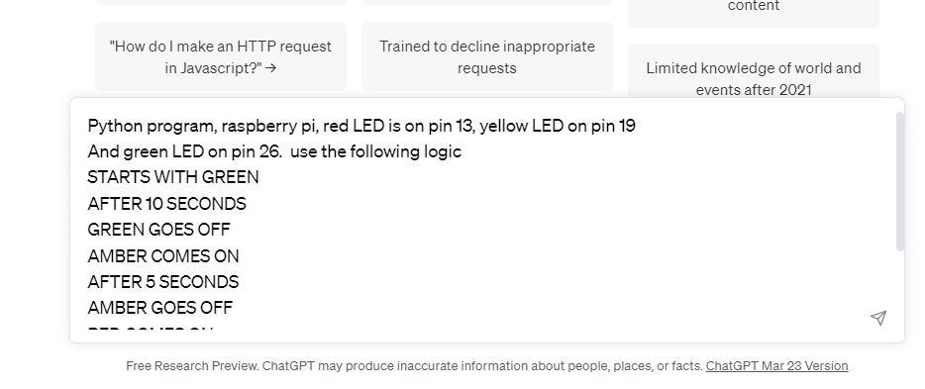
Click this and you will see ChatGPT
Write the program for you

Slide 13
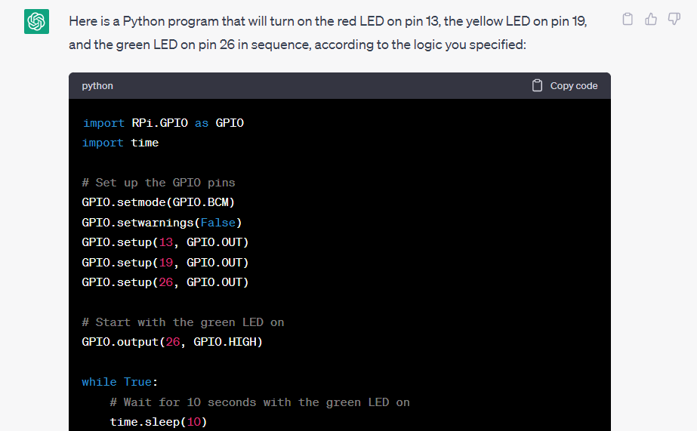
Copy this code
And paste into
The Thonny IDE

Slide 14
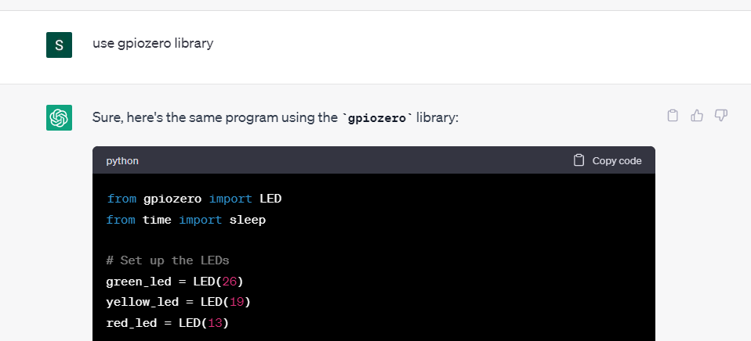
The code that ChatGPT gave me is not using the gpiozero Library
I can instruct it to use gpiozero library, and re-write the code for me

Slide 15


Exercise 3 – Wiring a Pedestrian Crossing
-VE
+VE
GROUND
PIN 14
PIN 18
PIN 24
PIN 25

Slide 16
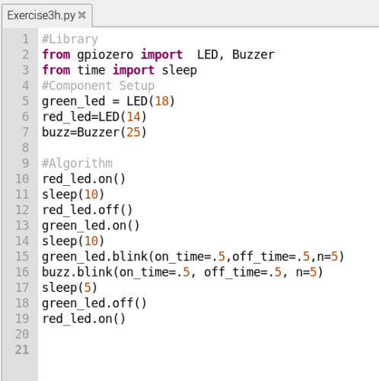
Ex. 3h Pedestrian Crossing Program – Version 2 – With Buzzer
Save program as Exercise3h.py
ALGORITHM FOR A PEDESTRIAN CROSSING
STARTS WITH RED
AFTER 10 SECONDS
RED GOES OFF
GREEN COMES ON
AFTER 10 SECONDS
GREEN BLINKS FIVE TIMES
BUZZER BLINKS FIVE TIMES
AFTER 5 SECONDS
GREEN GOES OFF
RED COMES ON

